Slide 1
Storyboard - Smart Support
Submitted by :Group-13 (21f1003002, 21f1003442, 21f1003481)

Slide 2
A student is facing a problem with her course and wants to contact the support team. She accesses the support ticketing system through the university website.

Slide 3
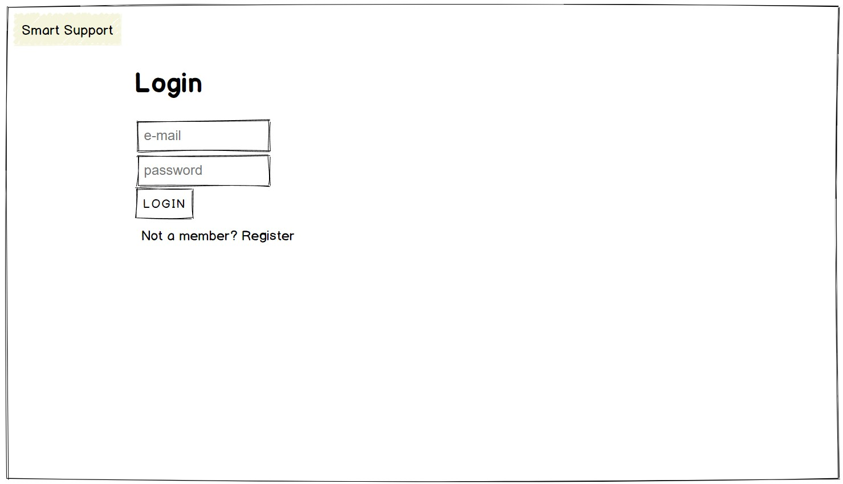
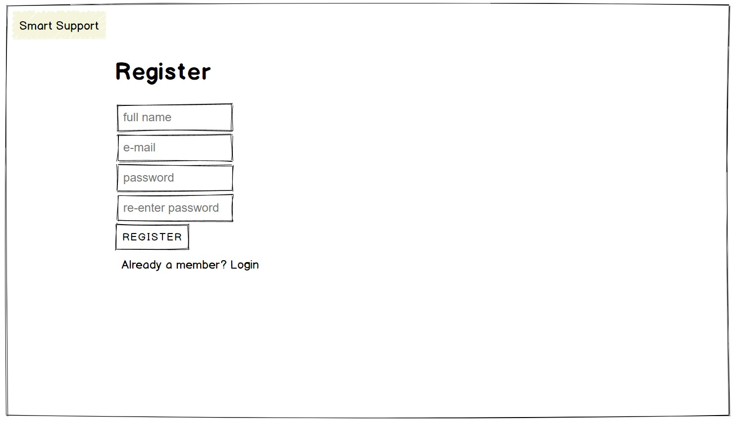
The student is presented with a login page where she needs to enter her credentials to access the support ticketing system. She can also click on Register link if she is new to the system.

Slide 4
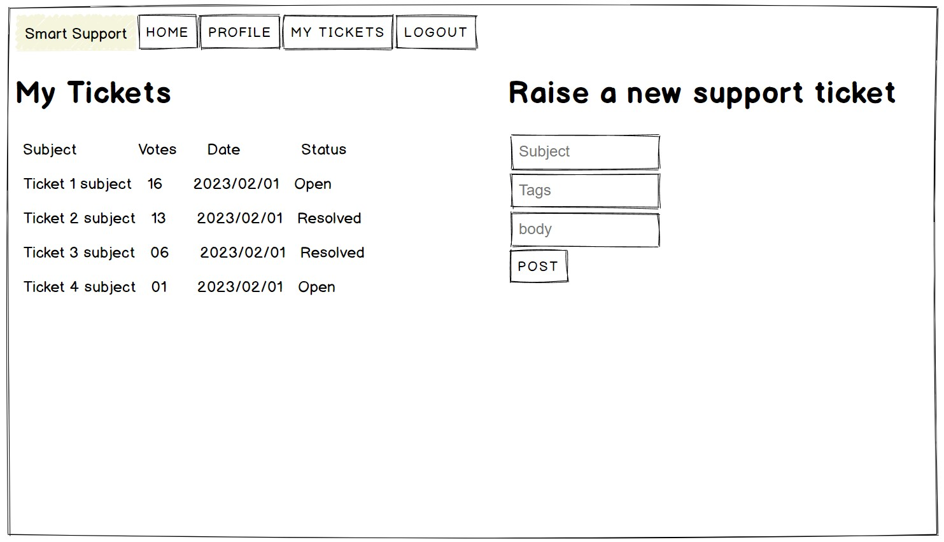
After logging in, the student is directed to the home page of the support ticketing system where she can create a new ticket or view her existing tickets.

Slide 5
In Raise a new support ticket form she can enter the details of her query or concern.
The system automatically checks if there are any similar tickets already created by other students.
If there are other similar tickets, the system displays the existing tickets to the student and prompts them to check if their concern has already been addressed.
She can also upvote an existing ticket.

